Slide 1
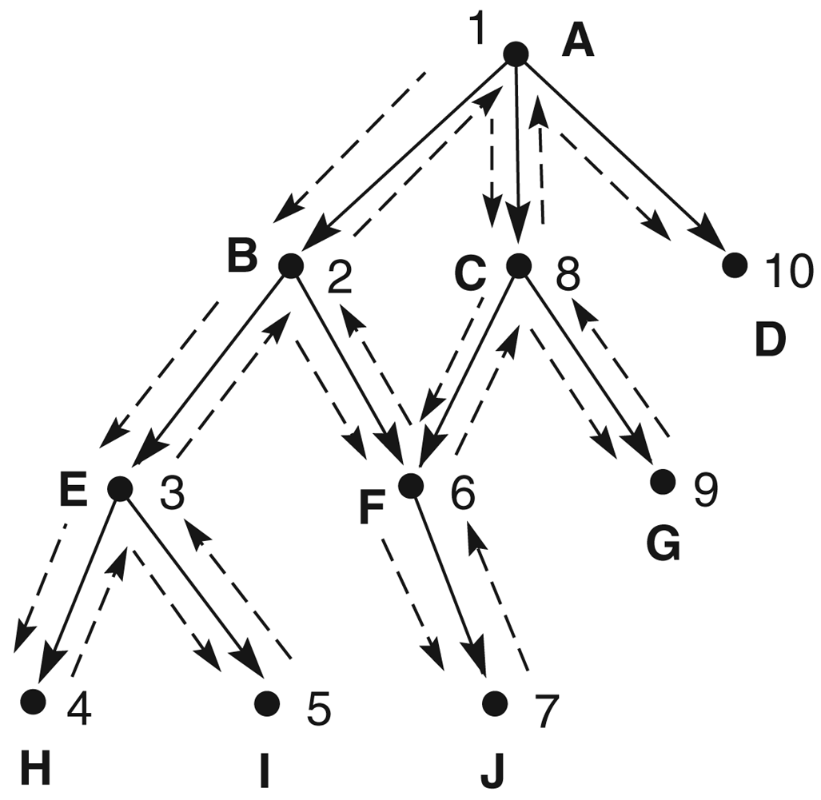

Slide 2
Depth First Search (DFS)
Breadth First Search (BFS)
A
A
1
1
7
10
C
3
B
D
B
2
D
C
2
8
4
9
5
9
F
G
E
E
5
6
F
G
3
6
4
7
H
I
J
H
8
I
9
J

Slide 3
Get the path from Node -A- to Node -A-
A
The DFS will start from -A- node then the path will be [A]
The BFS will start from -A- node then the path will be [A]
There is no recurse

Slide 4
Get the path from Node -A- to Node -B-
A
The DFS will start from -A- node then the path will be [A -> B]
1
B
The BFS will start from -A- node then the path will be [A ->B]
There is no recurse

Slide 5
Get the path from Node -A- to Node -E-
The DFS will start from -A- node then the path will be [A -> B -> E]
The BFS will start from -A- node then the path will be [A -> B -> C -> D -> E]
There is no recurse
A
A
1
1
B
C
3
B
2
D
2
E
4
E

Slide 6
Get the path from Node -A- to Node -H-
The BFS will start from -A- node then the path will be [A -> B -> C -> D -> E -> F ->G ->H]
The DFS will start from -A- node then the path will be [A -> B -> E -> H]
A
A
1
There is no recurse
1
C
3
B
2
D
B
2
4
E
F
6
G
5
E
7
3
H
H

Slide 7
Get the path from Node -A- to Node -I-
The DFS will start from -A- node then the path will be [A -> B -> E -> I]
The BFS will start from -A- node then the path will be [A -> B -> C -> D -> E -> F -> G -> H -> I]
There is recurse [H]
A
A
1
1
B
C
3
B
2
D
2
4
E
F
6
G
E
5
7
3
4
I
H
I
H
8

Slide 8
Get the path from Node -A- to Node -F-
The DFS will start from -A- node then the path will be [A -> B -> F]
The BFS will start from -A- node then the path will be [A -> B -> C -> D -> E -> F]
There is recurse [H,I,E]
A
1
2
A
B
1
2
B
C
3
5
2
D
E
F
4
3
E
F
5
4
H
I

Slide 9
Get the path from Node -A- to Node -J-
The DFS will start from -A- node then the path will be [A -> B -> F -> J]
The BFS will start from -A- node then the path will be [A -> B -> C -> D -> E -> F -> G -> H -> I -> J]
There is recurse [H,I,E]
A
A
1
1
B
B
C
3
2
D
2
5
4
E
E
F
6
G
F
5
3
6
4
7
H
I
J
H
8
I
9
J

Slide 10
Get the path from Node -A- to Node -C-
The DFS will start from -A- node then the path will be [A -> C]
There is recurse in [H,I,E,J,F,B]
The BFS will start from -A- node then the path will be [A -> B -> C]
A
1
7
B
C
A
2
1
5
E
F
B
C
2
3
6
4
H
I
J

Slide 11
Get the path from Node -A- to Node -G-
The DFS will start from -A- node then the path will be [A -> C -> G]
The BFS will start from -A- node then the path will be [A -> B -> C -> D -> E -> F -> G]
There is recurse in [H,I,E,J,F,B]
A
A
1
1
7
B
C
B
C
3
2
D
2
8
5
9
4
E
G
E
F
6
G
F
5
3
6
4
H
I
J

Slide 12
Get the path from Node -A- to Node -D-
The DFS will start from -A- node then the path will be [A -> D]
There is recurse in [H,I,E,J,F,B,G,C]
A
The BFS will start from -A- node then the path will be [A -> B -> C -> D]
1
7
10
B
D
A
C
2
1
8
9
5
9
E
B
C
3
F
G
2
D
3
6
4
H
I
J

